Slide 1
“Spotify Music Recommendation System” “Universal College of Engineering and Technology,vallioor”
NM ID | NAME
au962721103003 | Ganesha Muruga Perumal
Ramar Bose
Sr. AI Master Trainer

Slide 2
ABSTRACT
A recommendation system for music and song recommendations is a project that uses machine learning algorithms K-means clustering algorithms to analyze data on user's listening habits and recommend new songs that they may be interested in. Recommendation systems are widely used in the music industry. One of the reasons they have become so ubiquitous is due to the fact that online listener behavior is characterized by cognitive biases - users prefer to take mental shortcuts rather than evaluate a large range of music choices on a daily basis.

Slide 3
INTRODUCTION
In today’s competitive world, understanding customer behavior and preferences is crucial for customer retention and revenue generation. However, spotify music recommendations system often face challenges in analyzing customer data due to the sheer volume and velocity of data generated. Traditional data analysis methods are time-consuming and often fail to provide real-time insights. This lack of real-time analysis can lead to missed opportunities for customer engagement and customer satisfaction. Furthermore, the complexity and diversity of customer data, which includes customer details and their preferences.

Slide 4
Proposed Solution
Find optimal number of clusters using the Elbow method
Fit the K-means model
Add a column with the corresponding clusters
Find out the maximum occurring cluster number according to user’s favorite track types
Sort the cluster numbers and find out the number which occurs the most
Get the tracks of that cluster and print the first five rows of the dataframe having that cluster number as their type

Slide 5
Advantages
Data-Driven Decisions: Spotify music recommendations system makes decisions based on real-time data analysis.
Improved Customer Engagement: Understanding customer behavior and trends can help spotify music recommendation system engage with their customers more effectively.
Customer Satisfactions: By listing their preferences songs, customer will get satisfaction.

Slide 6
Services Used
Data Collection and Storage Services: Spotify music recommendations system need to collect and store customer data in real-time. During the Extract phase, PySpark was used to read and extract the relevant data from the datasets. The main dataset has been deployed to HerokuSQL Cloud Database and all model-related files retrieve data from there. Also, Deta Space cloud database is used to store the Bayesian Personalized Ranking model parameters.
Data Processing Services: PySpark was used to transform the extracted data into a suitable format for merging and analysis.
Machine Learning Services: The Bayesian Personalized Ranking (BPR) model has been deployed using FastAPI, Github Actions, and Deta as an API hosted on Heroku..

Slide 7
Tools and Software used
Tools:
1.Docker Python
2. Visual Studio Code
Software Requirements:
Python uses the following packages for this project.
1. requests
2. Spotipy
3. Streamlit
4. IPython
5. Pandas
FrontEnd
1.HTML
2.JavaScript File (.js)

Slide 8



high-level architecture
USER FRONTEND BACKEND
Database
HTML /.js HerokuSQL Cloud DataBase

Slide 9
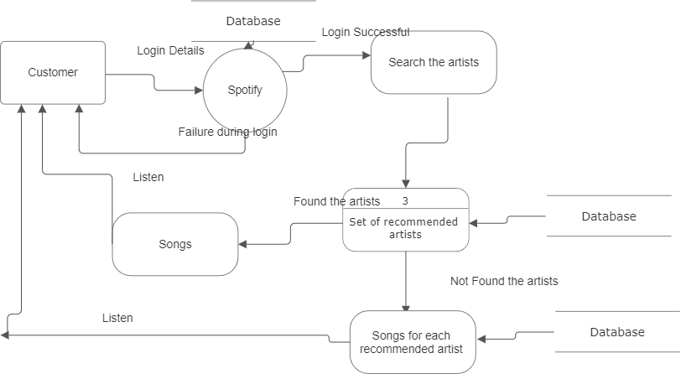
Data Flow Diagram

Slide 10
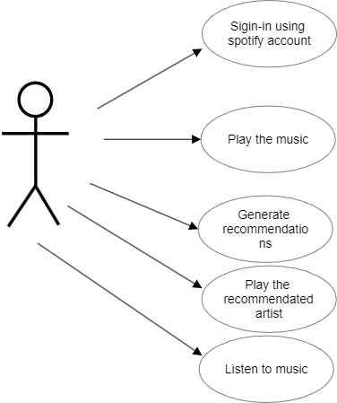
User Interface

Slide 11
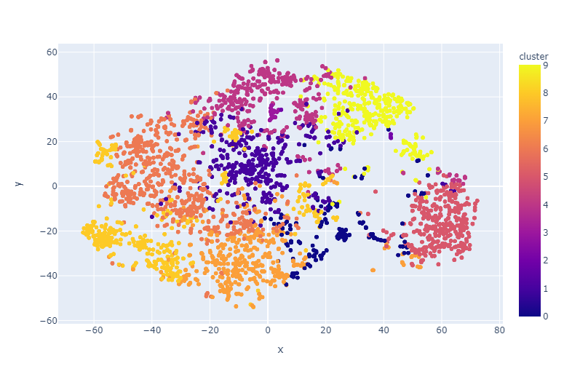
Clustering Genres with K-Means

Slide 12
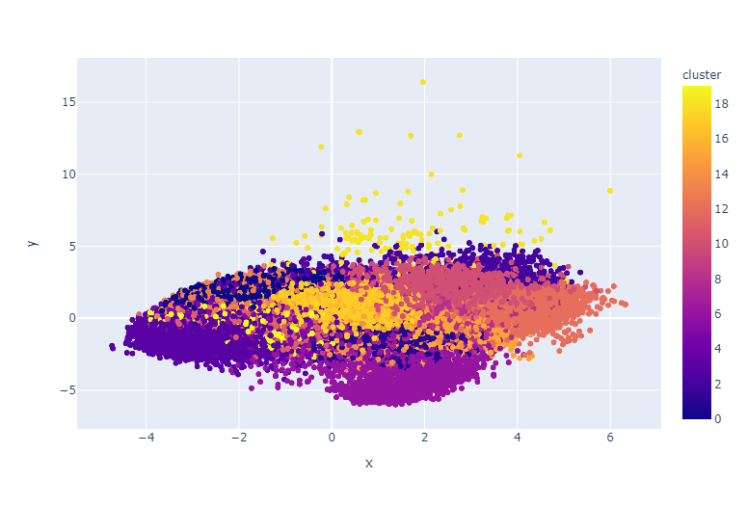
Clustering Songs with K-Means

Slide 13
CONCLUSION
The project “Spotify Music Recommendations System” has successfully demonstrated the potential of data analytics in the recommendations system. The real-time analysis of customer data has provided valuable insights into customer behavior, preferences, and trends, thereby facilitating informed decision-making. The interactive dashboards and reports have offered a comprehensive view of customer data, enabling the identification of patterns and correlations. This has not only improved the efficiency of data analysis but also enhanced the recommendation’s ability to provide personalized services to its customers. The project has also highlighted the importance of data visualization in making complex data more understandable and accessible. The use of Jupiter Notebook has made it possible to present data in a visually appealing and easy-to-understand format, thereby aiding in better decision-making.

Slide 14
FUTURE SCOPE
The future scope of this project is vast. With the advent of advanced analytics and machine learning can be leveraged to predict future trends based on historical data. Integrating these predictive analytics into the project could enable the recommendations system to anticipate customer needs and proactively offer solutions. Furthermore, It has the capability to integrate with various data sources opens up the possibility of incorporating more diverse datasets for a more holistic view of customers. As data privacy and security become increasingly important, future iterations of this project should focus on implementing robust data governance strategies. This would ensure the secure handling of sensitive customer data while complying with data protection regulations. Additionally, the project could explore the integration of real-time data streams to provide even more timely and relevant insights. This could potentially transform the way spotify music recommendations system interact with their customers, leading to improved customer satisfaction and loyalty.

Slide 15
REFERENCES
https://github.com/GANESHA2004/GANESHA-MURUGA-PERUMAL.N/tree/main/CODE, Ganesha Muruga Perumal , 2024
https://github.com/GANESHA2004/GANESHA-MURUGA-PERUMAL.N/tree/main/video, Ganesha Muruga Perumal , 2024
https://github.com/GANESHA2004/GANESHA-MURUGA-PERUMAL.N/tree/main/project%20report, Ganesha Muruga Perumal, 2024

